Slide 1
Submitted By:
Supervised By: Kunal Singh(181500341) Mr.Anand Gupta Shivam Kumar Rai(181500668)
Harshit Sachan(181500257)
Rahul Kumar(181500534)
Utkarsh Agarwal(181500769)
Quiz Overpowered
Mini Project

Slide 2
INTRODUCTION
In this project we have made a quiz web application.In this application user can create quiz and give quiz.This website will also let the user to know their scores from highest to lowest.

Slide 3
MOTIVATION
This web application aims at making life easy of an user by providing a very simple user interface to check their knowledge about various topics and ultimately enahancing one’s knowledge about a topic.

Slide 4
OVERVIEW
This quiz web application is made with several front-end as well as backend technologies.In this web application one have to first sign oneself up before attempting the quiz.Then user can select and attempt the quiz.

Slide 5
User can also select the number of questions,topic in which you want give the quiz and the difficulty whether you want to give the quiz in easy,medium or hard mode.

Slide 6
FRONT-END TECHNOLOGIES
HTML-HyperText Markup Language is the standard markup language for documents designed to be displayed in a web browser. Web browsers receive HTML documents from a web server or from local storage and render the documents into multimedia web pages. HTML describes the structure of a web page semantically and originally included cues for the appearance of the document.
CSS-Cascading Style Sheets (CSS) is a simple mechanism for adding style (e.g., fonts, colors, spacing) to Web documents.
JavaScript-JavaScript (JS) is a lightweight, interpreted, or just-in-time compiled programming language with first-class functions. While it is most well-known as the scripting language for Web pages, many non-browser environments also use it, such as Node.js, Apache CouchDB and Adobe Acrobat.

Slide 7
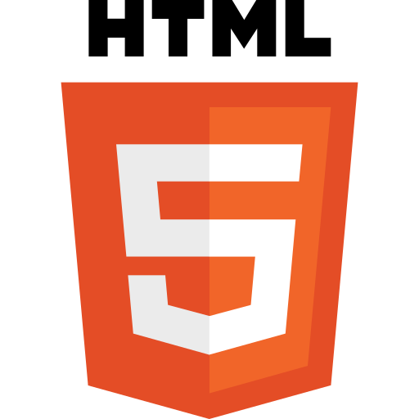
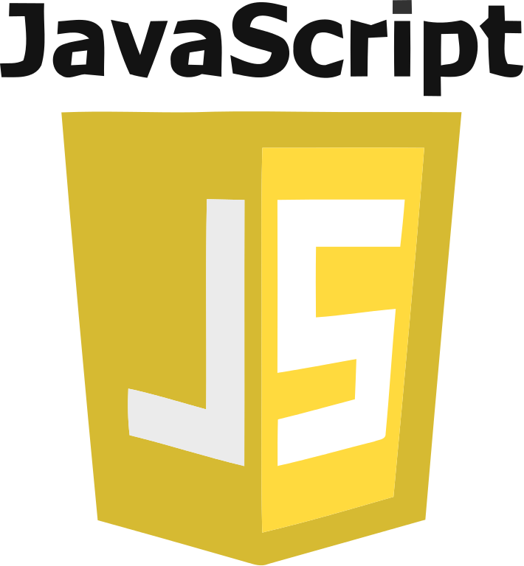
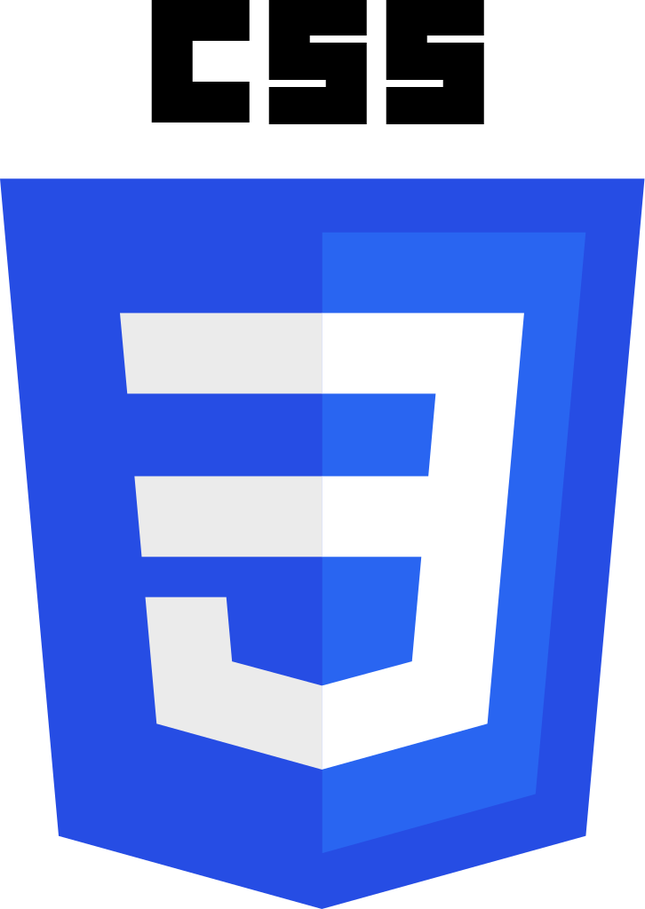

Bootstrap-Bootstrap is a free, open source HTML, CSS, and JavaScript framework for quickly building responsive websites.It supports responsive design and features predefined design templates that you can use out of the box, or customize for your needs with your code.

Slide 8
BACK-END TECHNOLOGIES
NodeJS-Node.js is a cross-platform JavaScript runtime environment that allows developers to build server-side and network applications with JavaScript. Node.js lets developers use JavaScript to write command line tools and for server-side scripting—running scripts server-side to produce dynamic web page content before the page is sent to the user's web browser.
ExpressJs-Express is a minimal and flexible Node.js web application framework that provides a robust set of features for web and mobile applications.It is designed for building web applications and APIs.It has been called the de facto standard server framework for Node.js.

Slide 9


jQuery-jQuery is a fast, small, and feature-rich JavaScript library. It makes things like HTML document traversal and manipulation, event handling, animation, and Ajax much simpler with an easy-to-use API that works across a multitude of browsers. With a combination of versatility and extensibility, jQuery has changed the way that millions of people write JavaScript.

Slide 10


TOOLS USED
VSCode-Visual Studio Code is a distribution of the Code - OSS repository with Microsoft specific customizations released under a traditional Microsoft product license.Visual Studio Code combines the simplicity of a code editor with what developers need for their core edit-build-debug cycle.
Hyper-A Highly Customizable prompt for shell.

Slide 11
FEATURES
1.It provides signup form whose data is stored on the mailchimp website database.
2.User can select number of questions,difficulty and subject.
3.User can give the quiz and can know the score.
4.User can also his scores from highest to lowest.

Slide 12
FUTURE PROSPECTS
In future we aim to add more features.They are as follows-
1.User will also be able to create quiz of questions they want add.
2.Make the authentication more strong.
3.Add more subject questions to the database for users.

Slide 13
THANK YOU!

